Slide 1


Atmospheric Measurement Techniques
NC A&T Lecture
March 7, 2011
Eric Apel apel@ucar.edu

Slide 2


Slide 3
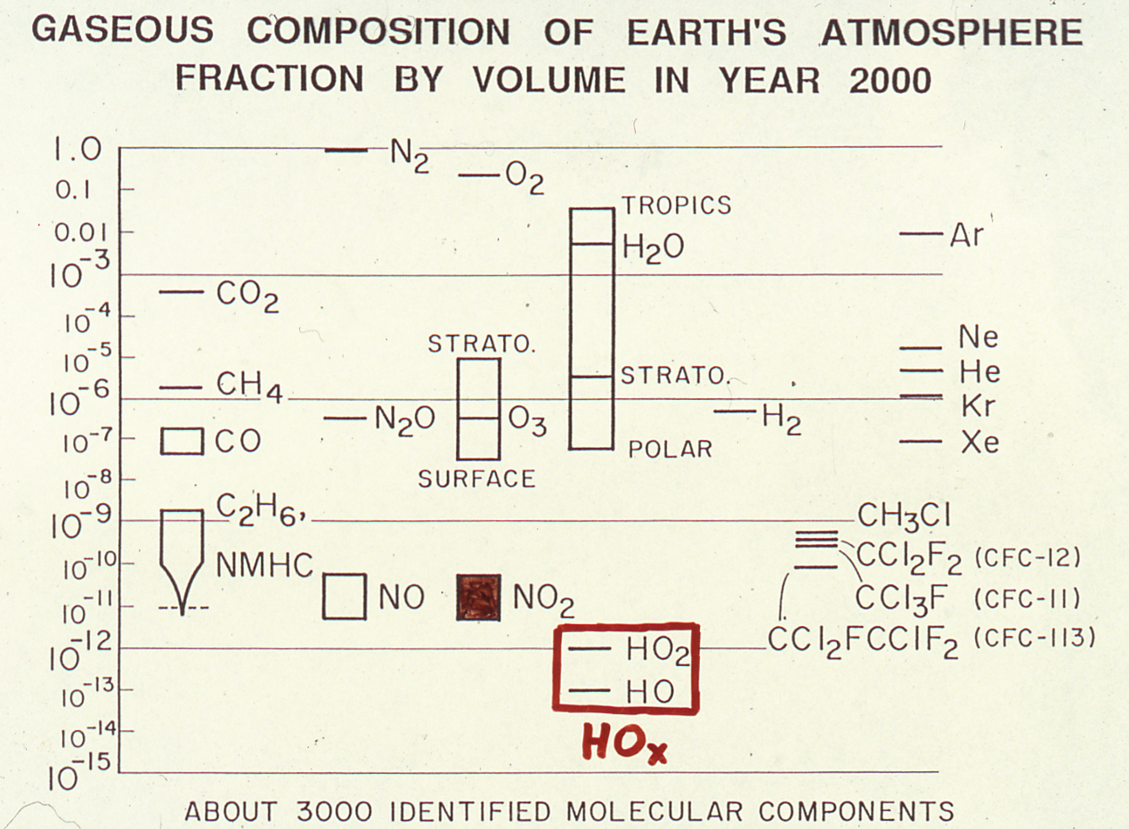
Compliments of FSR

Slide 4
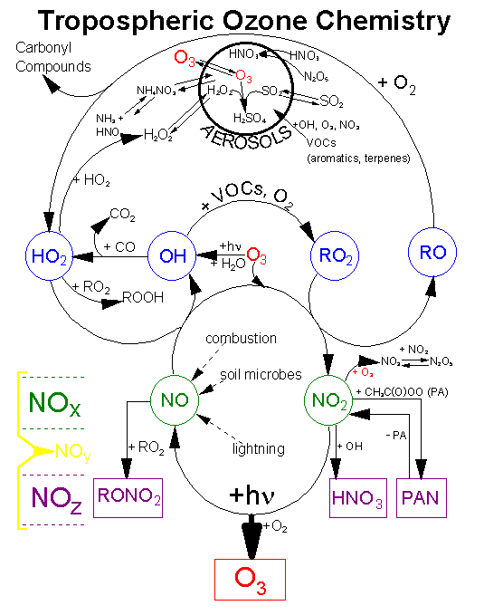
Introduction Continued
Gas phase:
        CO, CO₂
        O₃, NO, NO₂, NO_{y} (Custom, pptv, 1 sec)
        PANs (Custom, pptv, 1 sec)
        SO₂
        OH, H₂SO₄, MSA (Custom, ppqv, 1 sec)
        HO₂, RO₂ (Custom, pptv, 1 sec)
        CH₂O (Custom, 50 pptv, 1 sec)
        H₂O₂, CH₃OOH, HOCH₂OOH, HCN, SO₂, HNO₃,…
        VOC, tracers (Trace Organic Gas Analyzer)
        VOC, aromatics, tracers (PTR-MS)
        NMHC, tracers (Canister air sampler)

Slide 5
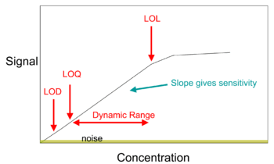
Introduction Continued
Many different ways to measure/analyze
Which technique is the best?
How well do different techniques compare?
Instrumentation requirements:
Exceptional sensitivity
Low limit of detection (ppbv – ppqv)
Good selectivity
Good time resolution – esp for aircraft
Accurate and reproducible
Robust, portable, cheap, …
Example Working Curve
Dynamic Range
At the LOD we can say confidently analyte is present, but can’t quantify reliably
Limit of quantitation (LOQ): generally 10 times stdev of blank (10s_{bl})
Limit of linear response (LOL): signal is no longer proportional to concentration
Dynamic range = LOL/LOQ → 10² – 10⁶
Slide courtesy of J. Jimenez, CU

Slide 6
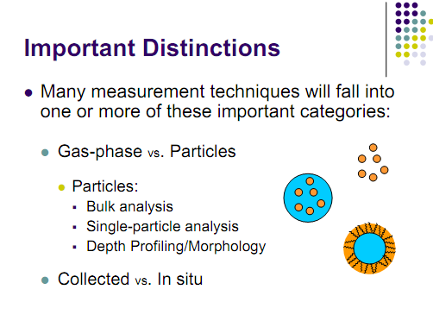

Slide 7
Collection Techniques
Collect gases for subsequent analysis
Must avoid interferences from particles
Must collect enough to be measurable
Sampling times are usually quite long (min to day)
Be careful of time resolution of measurements
From total volume of air sampled and the amount of the analyte measured, the average concentration of the species over experimental time range is determined
Beware of sampling artifacts
Reaction, decomposition, evaporation, etc.

Slide 8
Canister VOC Measurements
Collection of whole air samples for subsequent analysis using chromatographic methods
Examples of VOCs that can be measured:
C₂-C₁₀ NMHCs
C₁-C₂ Halocarbons
C₁-C₅ Alkyl Nitrates
OCS, CS₂, DMS, selected OVOCs

Slide 9
In-situ Techniques
Some Examples – radicals as well as stable molecules:
IR Spectroscopy – Formaldehyde, CO, CO2 Measurement
Chemiluminescence – NO_{x,y}, O₃ Measurement –
Mass Spectrometry: e.g., OH – CIMS (chemical ionization mass spectrometry), PTR-MS, GC-MS
Laser induced fluorescence – LIF: OH, NO2, PANs
Measure on-the-fly
Sampling times are usually very short (seconds to milliseconds)
Must have sufficient sensitivity (duh)
Beware of sampling artifacts
Also remote techniques – e.g., satellites, LIDAR, etc.

Slide 10
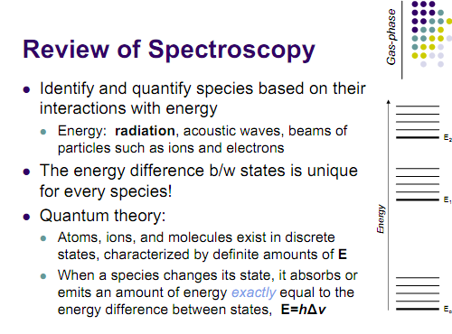

Slide 11
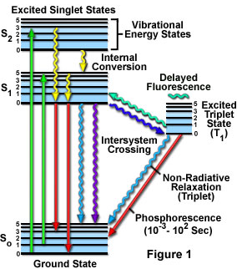
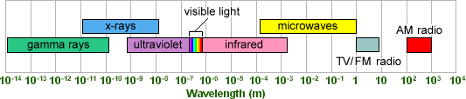
Review of Spectroscopy
Absorbance:
Select frequencies are removed from the
incident light by absorption.
Absorption promotes molecules from
ground state to an excited state.
Analytical techniques: IR and UV-VIS
Emission:
Select frequencies are emitted when
excited molecules return to ground state
Initial excitation occurs by irradiation or rxn
Analytical techniques: Fluorescence and
Chemiluminescence

Slide 12
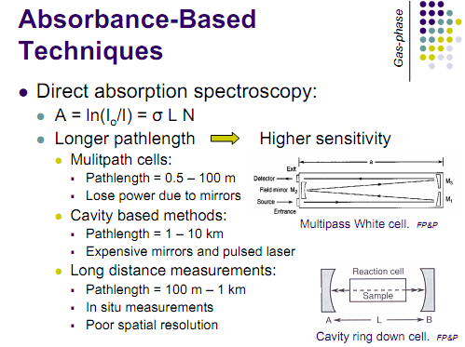

Slide 13
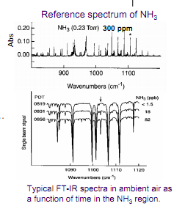
Absorbance-Based
Techniques
Challenges:
Every molecule has an
absorption spectrum of
some sort
It is difficult to separate
contributions to absorbance
from different molecules
Abs = ln(I₀/I) = Σ(σ_{i} × L × n_{i}) i = 1,2,3,…
Useful only for analysis of
molecules with structured
absorbance spectra
See NH₃ example
Nice tutorial : http://www2.chemistry.msu.edu/faculty/reusch/VirtTxtJml/Spectrpy/InfraRed/infrared.htm

Slide 14
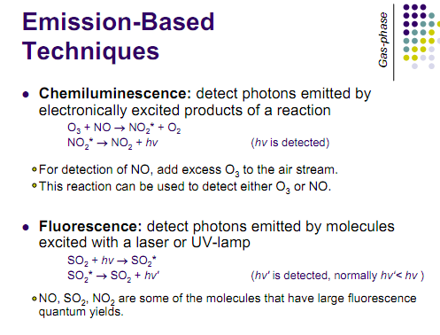

Slide 15
Mass Spectrometry
A small sample is ionized, usually to cations by loss of an electron. The Ion Source
2. The ions are sorted and separated according to their mass and charge. The Mass Analyzer
3. The separated ions are then measured, and the results displayed on a computer. The Detector
The Mass Spectrum:
Graph of ion intensity vs mass-to-charge ratio

Slide 16
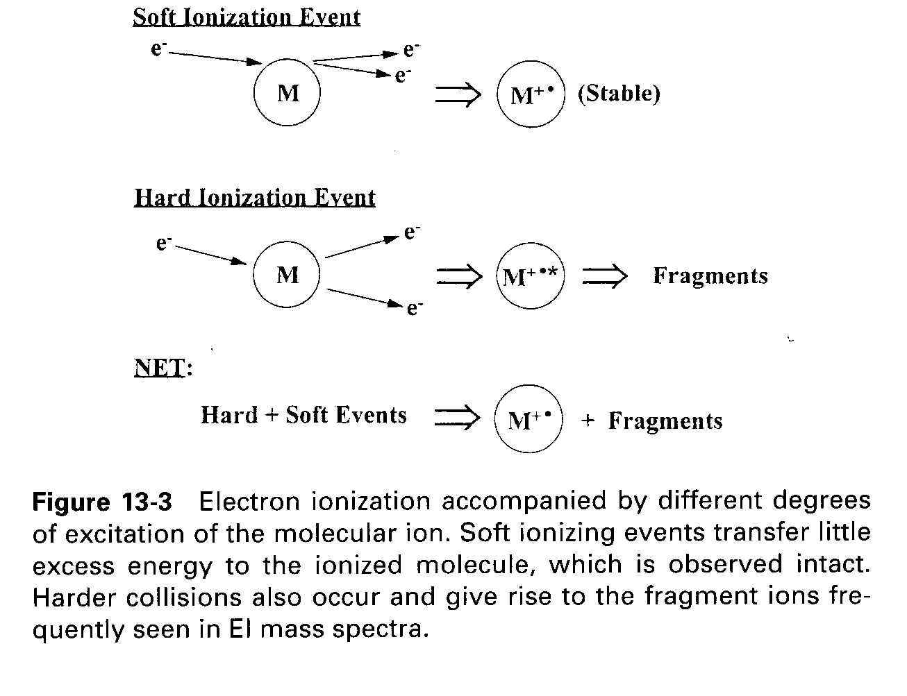
Electron Impact Ionization (EI)

Slide 17
Chemical Ionization, CI (CIMS)
Gaseous atoms of the sample are ionized by collisions with ions produced by electron bombardment of an excess reagent gas – many uses exploited in recent times
Schemes developed for detection of PAN OH, HO2, NH3, VOCs (PTR-MS)…..
Most common – positive ions, but negative ions are used (e.g., PAN CIMS) with analytes containing very electronegative atoms

Slide 18
PTR-MS for Fast Response VOC Measurements – chemical ionization technique
Alcohols: methanol
Aldehydes: formaldehyde, acetaldehyde, pentanal, pentenal, 3-methyl butenal
Ketones: acetone, methyl ethyl ketone, methyl vinyl ketone, methacrolein
NMHCs: isoprene, benzene, toluene, C8-aromatics, C9-aromatics,
C10-aromatics, terpenes
Others: acetonitrile, DMS

Slide 19
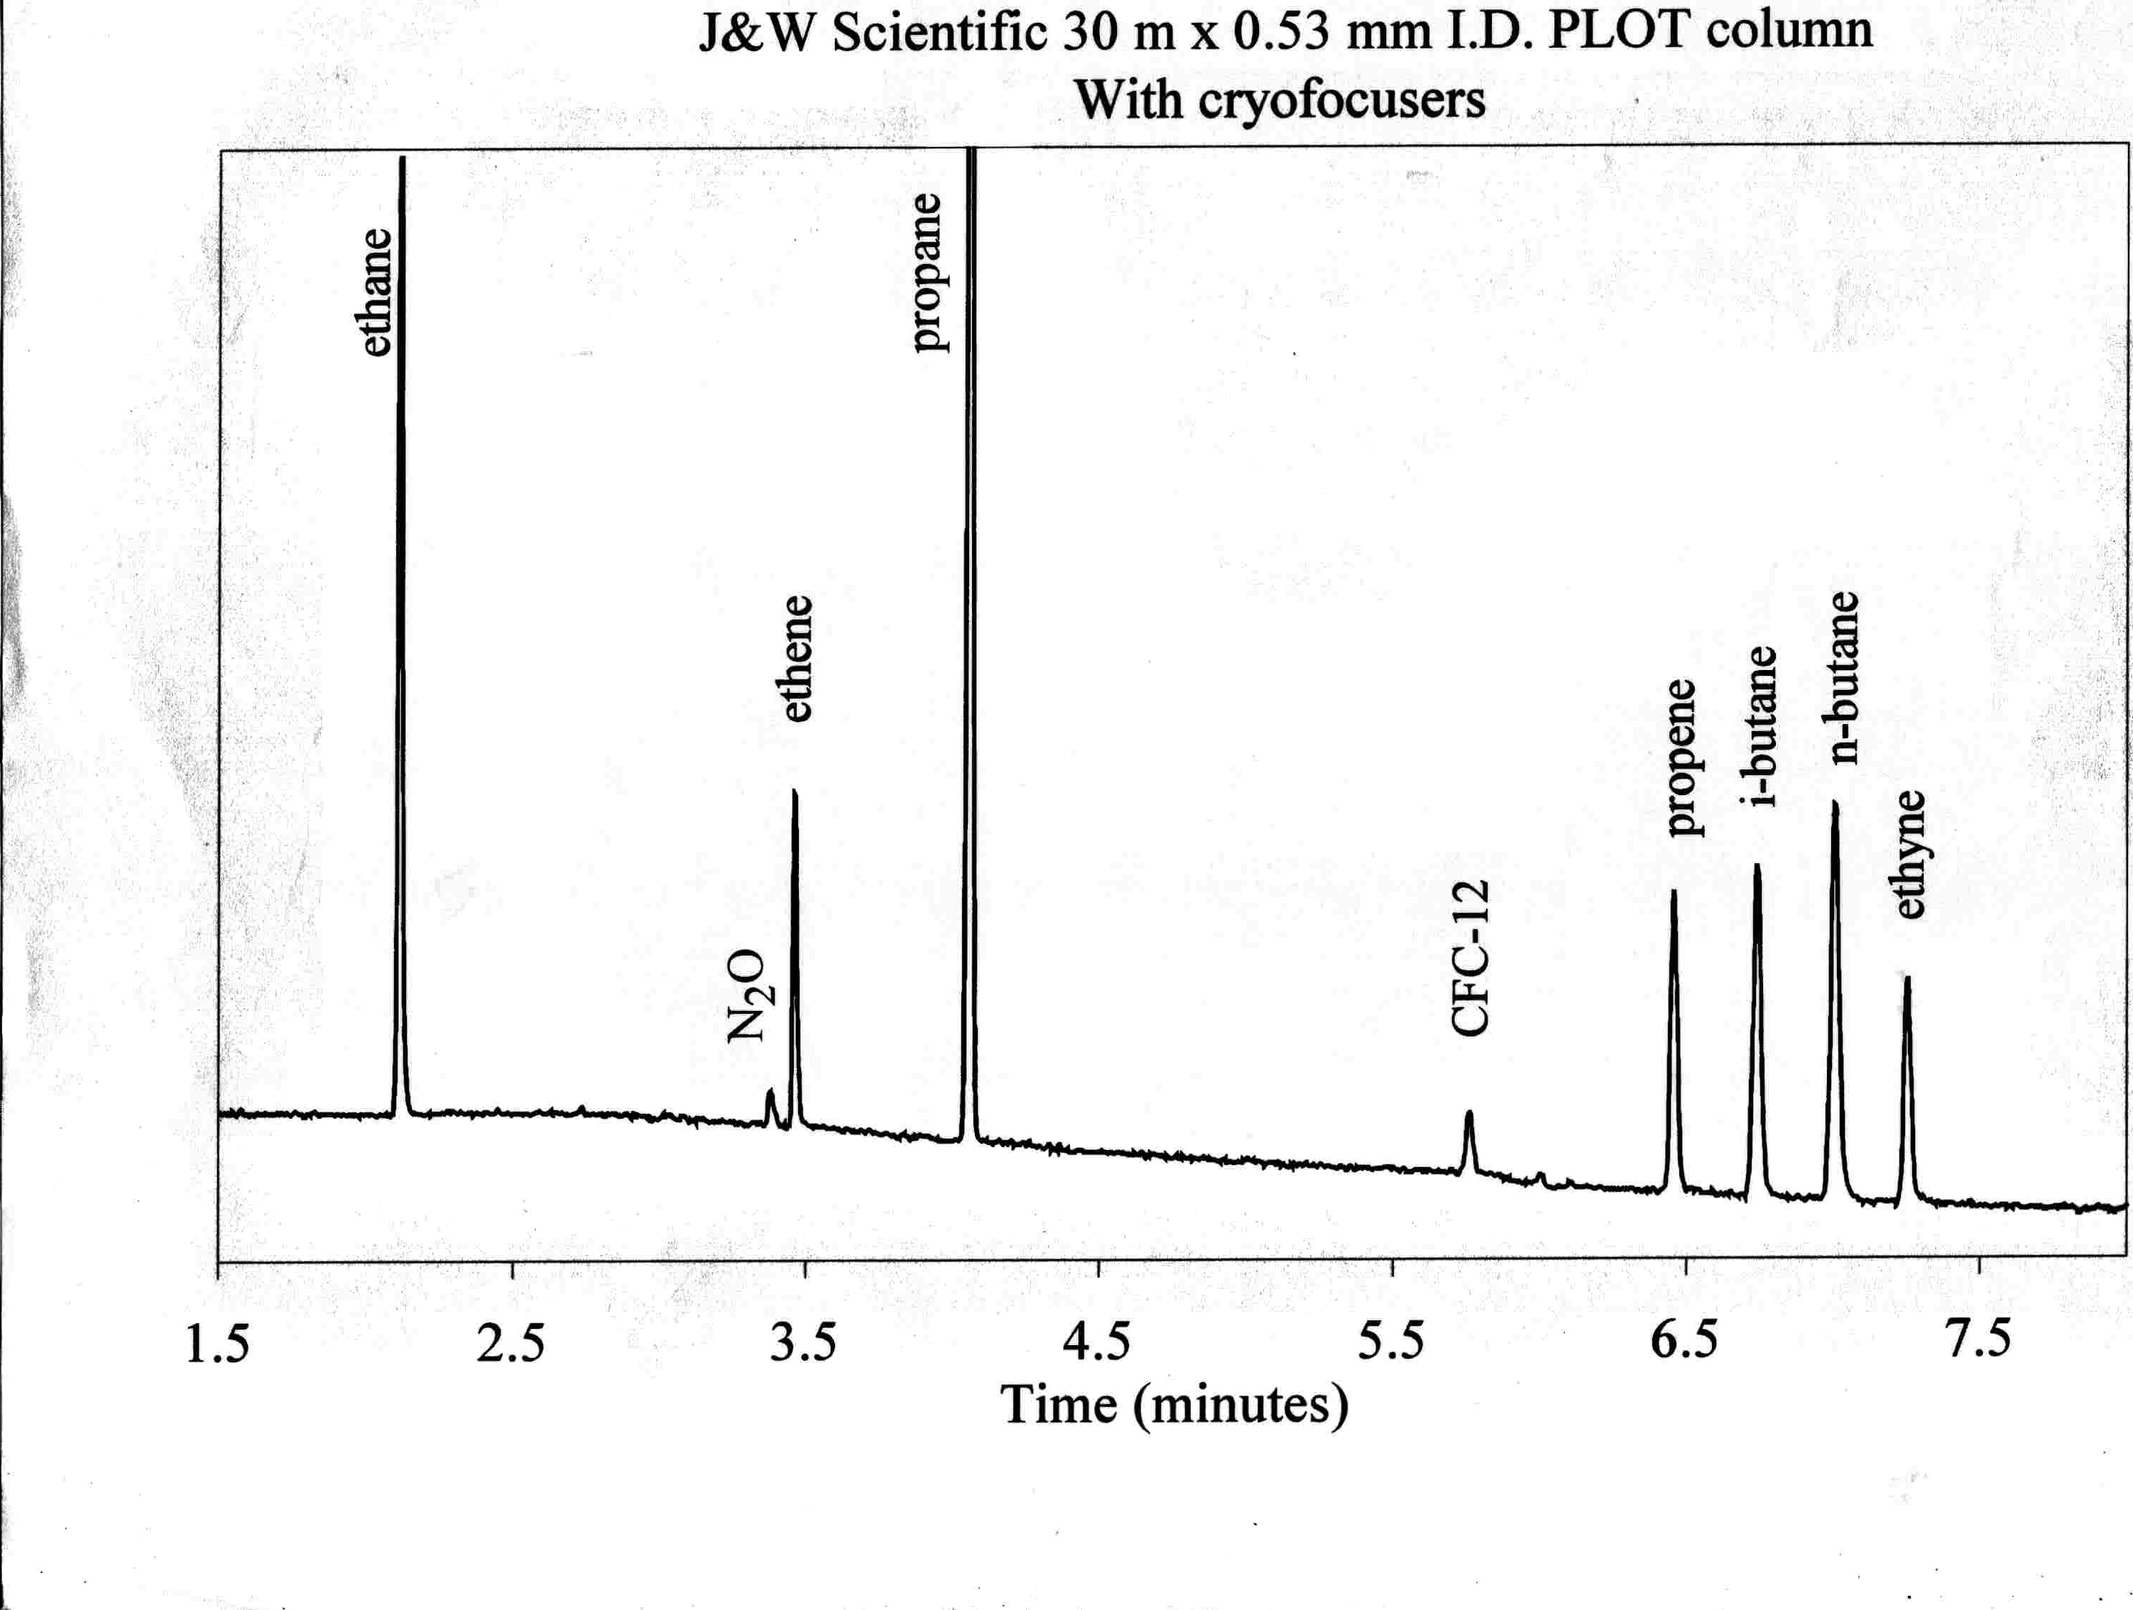
Combination techniques – e.g., GC-FID, GC-MS
Complex Matrix – or multiple species with similar characteristics
Separate and then detect

Slide 20
Theory of Chromatography
Primer for Tuesday:
http://www.chem.uoa.gr/Applets/AppletChrom/Appl_Chrom2.html

Slide 21
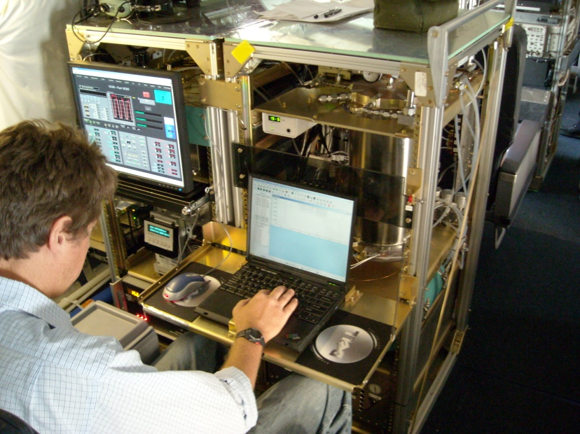
TOGA – trace organics analyzer

Slide 22
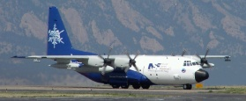
C-130 Measurement Payload
Most instruments are research-grade
Gas phase:
        CO, CO₂
        O₃, NO, NO₂, NO_{y} (Custom, pptv, 1 sec)
        PANs (Custom, pptv, 1 sec)
        SO₂
        OH, H₂SO₄, MSA (Custom, ppqv, 1 sec)
        HO₂, RO₂ (Custom, pptv, 1 sec)
        HNO₃
        CH₂O (Custom, 20 pptv, 1 sec)
        H₂O₂, CH₃OOH, HOCH₂OOH, HCN, SO₂, HNO₃,…
        VOC, tracers (Trace Organic Gas Analyzer)
        VOC, aromatics, tracers (PTR-MS)
        NMHC, tracers (Canister air sampler)
Particle Phase:
        Soot Sampler
        Aerosol Phys. + Optical Properties
        Aerosol Hygroscopicity + Volatility
        AMS (Aerosol mass spectrometer)
        SP2, CNC, filters
        PILS (liquid sampler)
        Sable (remote aerosol)
*Includes some measurements by non-NCAR collaborators

Slide 23
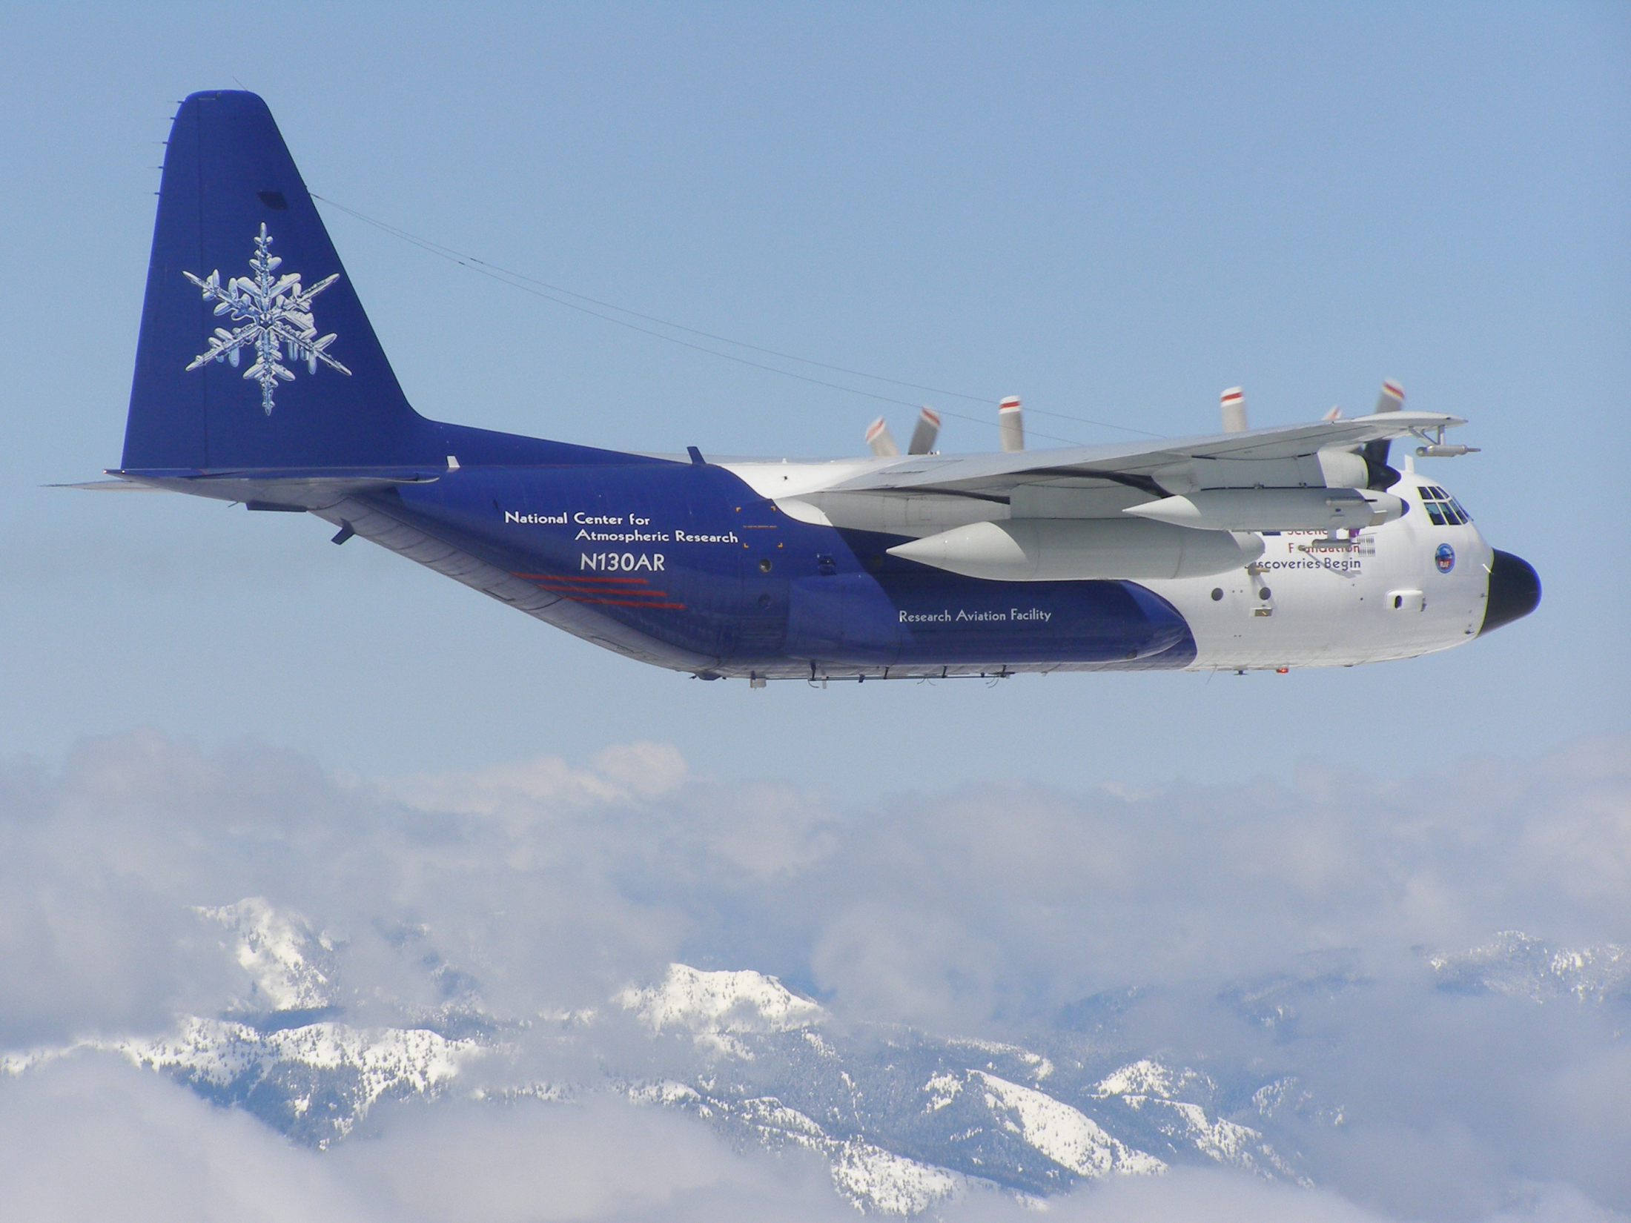
NCAR / NSF C-130

Slide 24

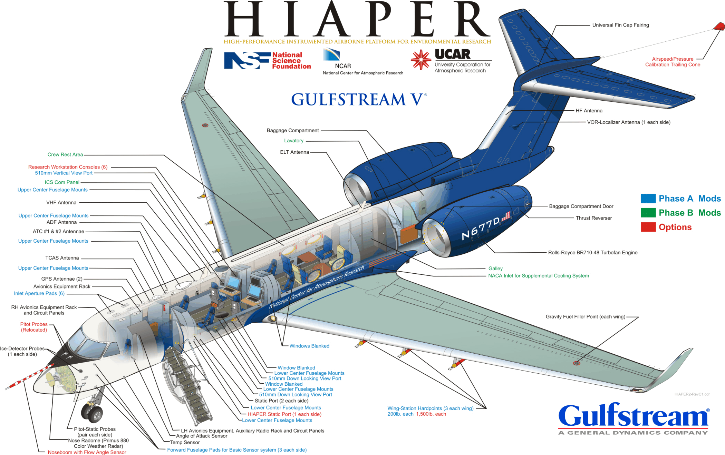


Upper troposphere studies
Violent convection studies

Slide 25
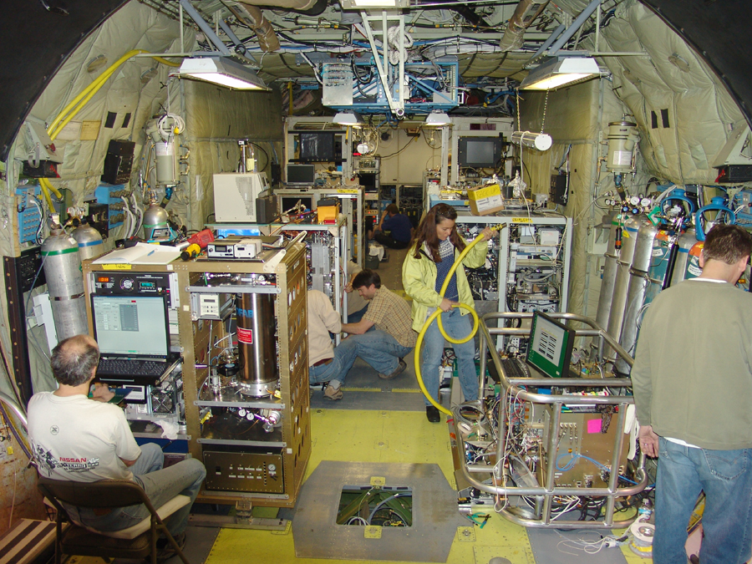
Photo: Jeff McCoy

Slide 26
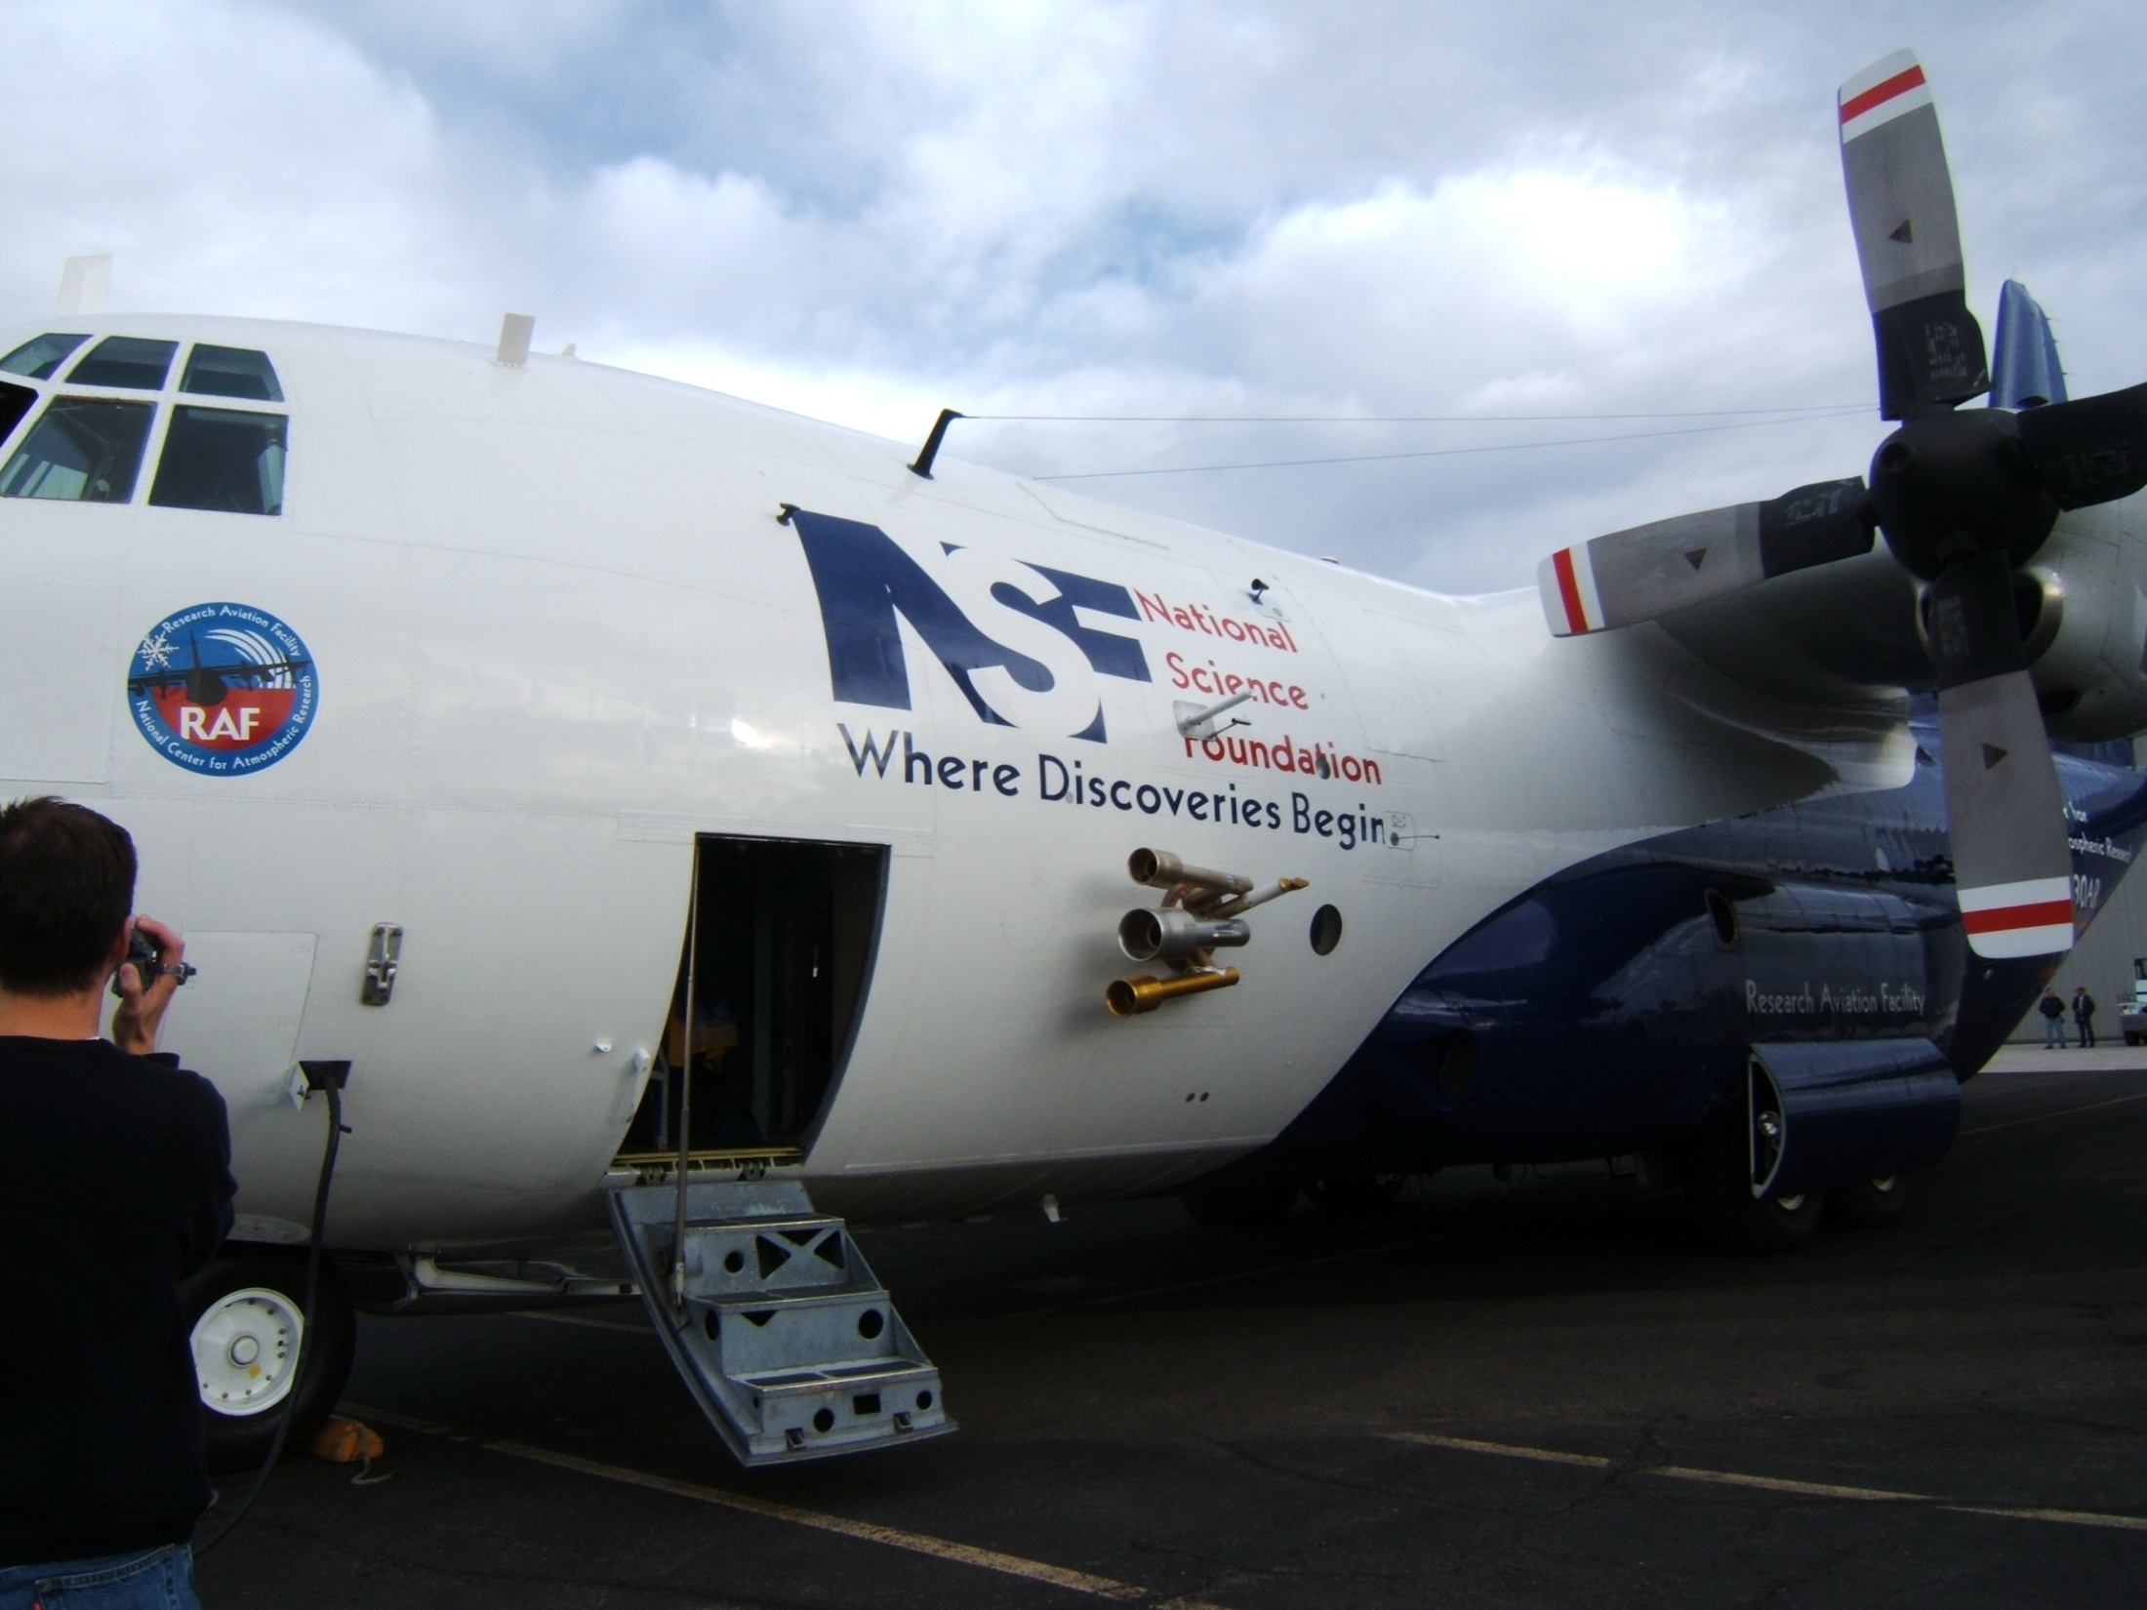
NCAR C-130
HOx

Slide 27
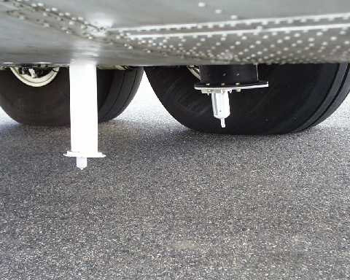

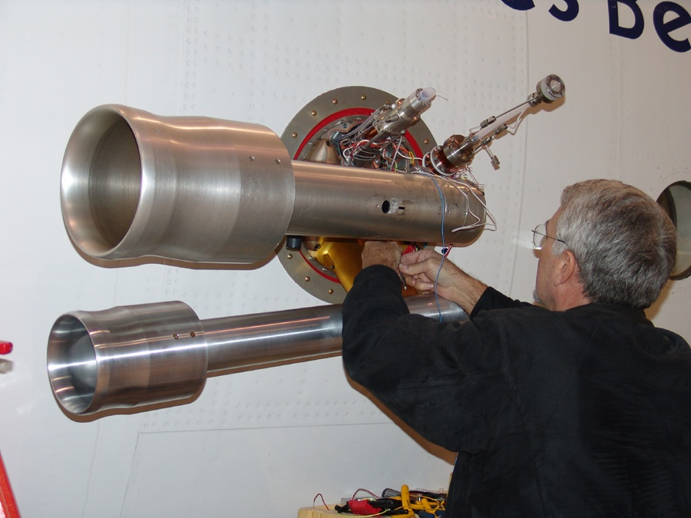
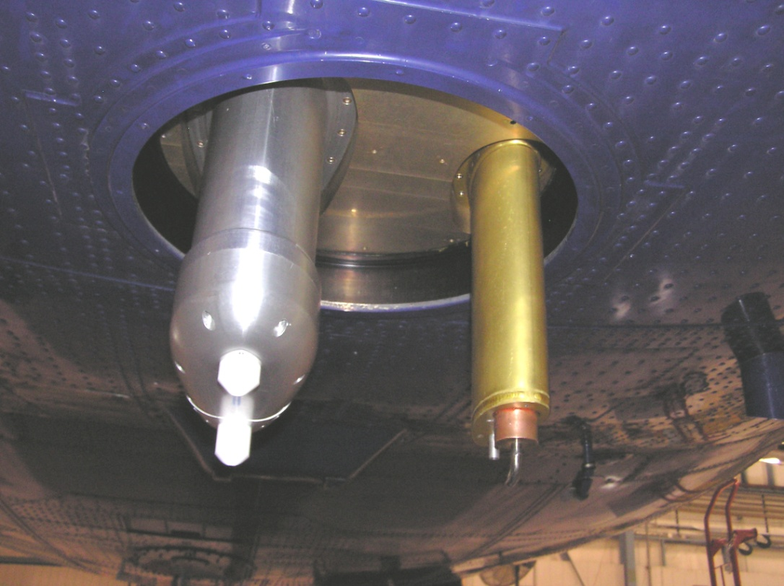
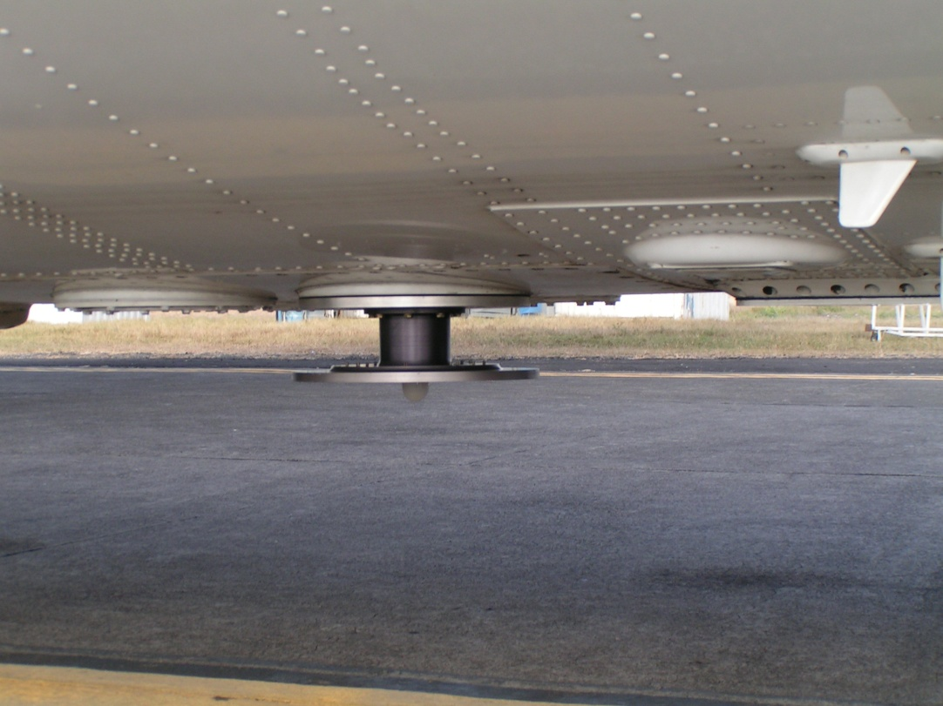
PAN
HOx
NOx
Radiation
TOGA
O₃

Slide 28
Inlet considerations – each highly specialized:
NOx and O₃ inlets are teflon, with pressure control starting just inside plane. NOy inlet has teflon P-control valve very close to inlet tip and then the gold converter is in that pylon. Temperature is controlled on all teflon lines at 50 deg C upstream of converter. Converter is located about 8 inches from the inlet tip in and is maintained at 300 C. The P control drops the residence time and is set to a pressure just a bit lower than pressure expected at highest altitude anticipated for the project
The OH/sulfuric acid inlet was designed to straighten and slow the flow of sampled air by a factor of sixteen in a non-turbulent fashion to minimize losses of OH and sulfuric acid, both of which are lost on first contact with surfaces. This requirement is not necessary for the HO2/RO2 inlet, which can sample orthogonally to the airflow and was designed to reach out beyond the wake of the OH inlet.
PAN - 1/4" OD PFA tubing through Teflon embedded within an alumina block and heated to 27 degree C. The inlet is pressure –controlled at140 Torr by a MKS640 which allows for a constant mass flow of 1.6 slpm through a 0.86 mm diameter orifice into the PAN system.
TOGA - Trace Organic Gas Analyzer - 1/4" OD highly polished SS tubing embedded within a copper block at the tip and heated to 45 degrees C. The inlet is pressure is controlled at 500 Torr by a MKS640 pressure controller. All lines are heated up to the instrument.

Slide 29
Types of Gases
Inorganic gases
Contain O, N, S, Cl, Br, and maybe H or C, but not both
Nitric oxide --
Carbon dioxide --
Organic gases
Contain both H and C, but may also contain other atoms
Formaldehyde --
Acetone --
Peroxyacetylnitrate --

